Slide 1
Exploring ADR of diabetes medicine using social media analytics and interactive visualizations
Pritish Naik (192422IT010)
Rohit Meshram (192090IT017)

Slide 2
Motivation
Why social media makes sense?
60% of physicians believe that the transparency and authenticity of social media actually helps improve the quality of care delivered to patients.
41% of online users agree that their choice of a specific doctor, hospital, or medical facility will be influenced by word of mouth on social media
How online health community (OHC) helps?
traditional data analysis
manually identify new perspectives from patient data
are not feasible or efficient
OHC is social networking platform where patients can discuss their health concerns and share their experience with other patients or health professionals

Slide 3
Literature review
Issues related to Adverse drug reactions
ADRs have been monitored by the FDA in US and ADR surveillance relies on FAERS
Pre-marketing stage: Each drug is investigated by clinical trials.
Post-marketing stage: The surveillance continues by self-reporting from pharmaceutical companies, hospitals, and consumers.
FEARS is restricted by its passive nature and only covers a fraction of knowledge available.
The insufficiency of ADR knowledge, is addressed by intelligently extracting new insights to understand drugs’ side effects from patient centric online communities on social media
As per Hazell & Shakir, 2006; Ji et al., 2011, estimated reporting rate of ADRs in the existing system < 10%
As per Harpaz et al., 2012, results in > 2 million injuries, hospitalizations, and deaths per year in the US alone and an increase in costs estimated at $75 billion annually
The three most commonly used information extraction techniques are
text classification, lexicon-based entity recognition and ADR relation extraction.

Slide 4
Outcome of Literature Survey
traditional statistical methods are insufficient
regression models or data mining approaches are used to discover the pattern of ADRs
Data extraction and classification approaches are used to automatically obtain meaningful ADR information
However, ADR information stored in OHC is rarely discovered, analyzed and visualized
We need
automatic information extraction,
real-time text analytics
and automatic topic modeling on forum and social media data.
Data visualisation is not emphasized
The developed data mining frameworks lack the capability to present the results in a visual, interactive, and real-time way.
Therefore, it is difficult for healthcare practitioners to interpret the results from social media to obtain new insights into ADR surveillance

Slide 5
What does the paper propose?
This paper proposes an automatic and real-time social media analytics framework with interactive visualizations to support effective exploration of knowledge about ADR surveillance.
A case study on a longitudinal diabetes patient social media platform
AskaPatient.com
FDA Adverse Event Reporting Systems (FAERS) data
The dataset from these sources are used as a benchmark to evaluate author’s approach performance.
The contents provided from patient drug experiences of a particular diabetes drug with respect to time, gender of patients, age group of patients and associations are analysed

Slide 6
Research methodology
Data extraction
To understand the ADRs, The author collected patient-provided comments on a specific diabetes drug (i.e., Glucophage) from the FAERS and and online health community
FEARs
The FAERS datasets are available for the public form.
Each data point is an individual report of an adverse drug event.
AskaPatient.com
participants share their opinions and experiences about specific diseases with respect to diagnosis, symptom management, drug usage and treatment as well as a five-point scale rating.
Preliminary data cleaning was performed using python programming language with cleaned historical data as reference.

Slide 7
Research methodology
Data analysis
Data analysis tools were used to process all kinds of data
Ratings
Comments
The Askapatient.com dataset was cleaned up and modeled to extract ADRs at this stage.
NLP used for data processing and manipulations.
the python pattern module developed by the CLiPS was used in this phase.
Step 1: stop words removal and text normalization
comments can be colloquial and the words have no info. ( stop words )
data provided by users on Askapatient.com is text, so text normalization is performed
Step 2: text tokenization and information gain model
The text is tokenized into 3g.
After this tokenization, the information gain model is applied.

Slide 8
Research methodology
Data Analysis
Step 3: information extraction for the top ADRs
Based on the information gain that each n gram provides in accurately predicting the ratings given by Askapatient.com
rating 1 [very dissatisfied with the medicine] and 5 [very satisfied]),
the presence of these top ADRs in particular reviews are captured by forming binary flags for each of these side effects.
If the particular side effect is present in the review, then the corresponding binary flag in the data is updated as 1, else 0.
Data visualization
The iterative visualizations page is made possible by Tableau,
Interactive visualizations are made from the different data sets combined.

Slide 9
Flowchart
Askapatient.com OHC
Facebook
Extract Facebook dataset
Extract Askapatient dataset
Remove stop words and similar words to Glucophage. Then perform normalization and cleaning
Filter out unnecessary columns
If side effect exists extract words in it
Read each comment
Create a model using Information gain
Remove stop words and similar words to Glucophage. Then perform normalization and cleaning
Set the Boolean flag for a ADR if it exists, Here the spelling mistakes are considered
Remove unimportant words to be skipped
Create a model with clean features
With each ADR as column, create table and extract it into CSV file
Validate results using k fold cross validation using SVM, NB,SLP etc
Extract results into csv

Slide 10
Implementation specifics [code]

Slide 11
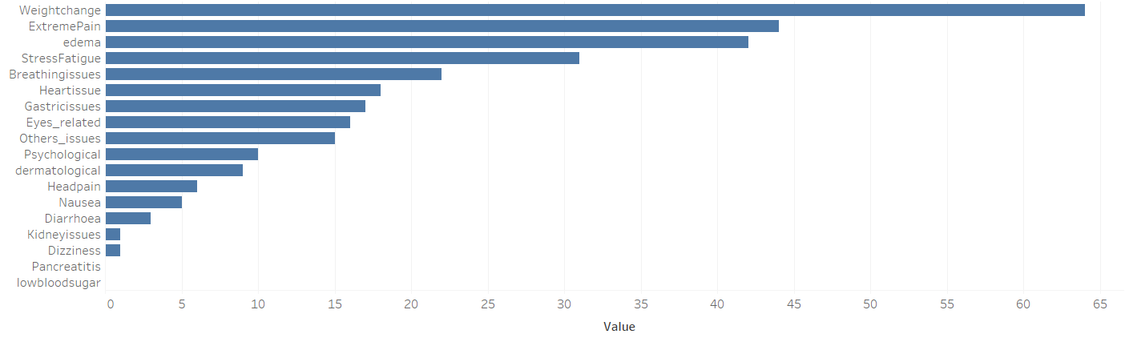
Results - Askapatient ADR for Glucophage drug
Top 3 adverse drug reactions:
Weight-change
Extreme pain
edema
Low other issues means whatever adverse drug reactions that were considered

Slide 12
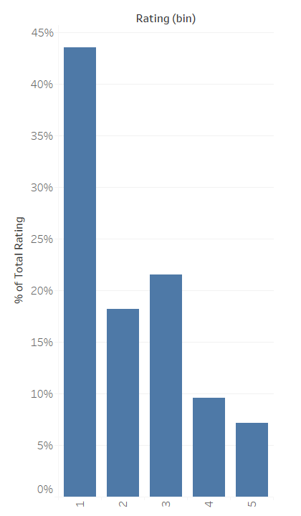
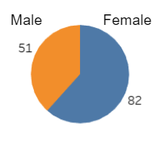
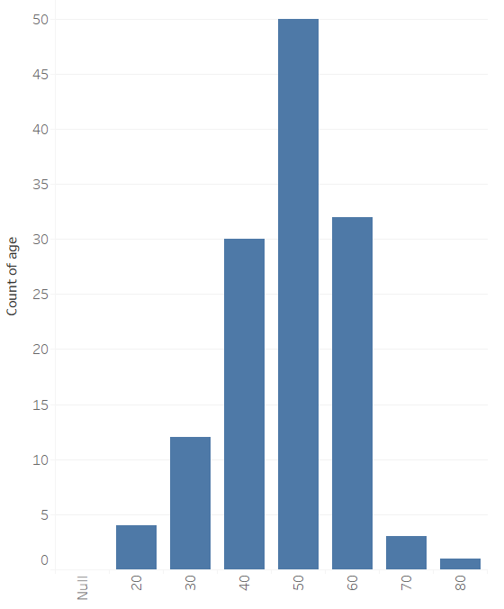
Results - Askapatient ADR for Glucophage drug
Gender analysis
Age analysis
Rating analysis

Slide 13
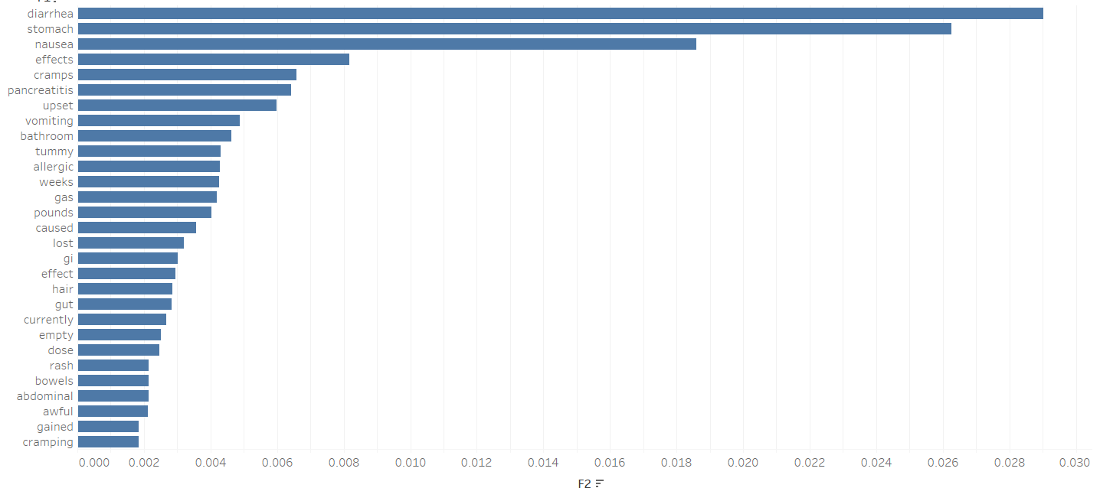
Results - facebook dataset analysis
The top 3
Diarrhoea
Stomach issues
nausea

Slide 14
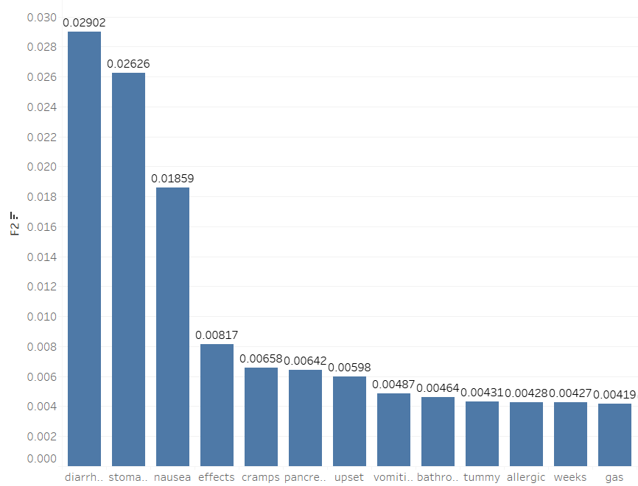
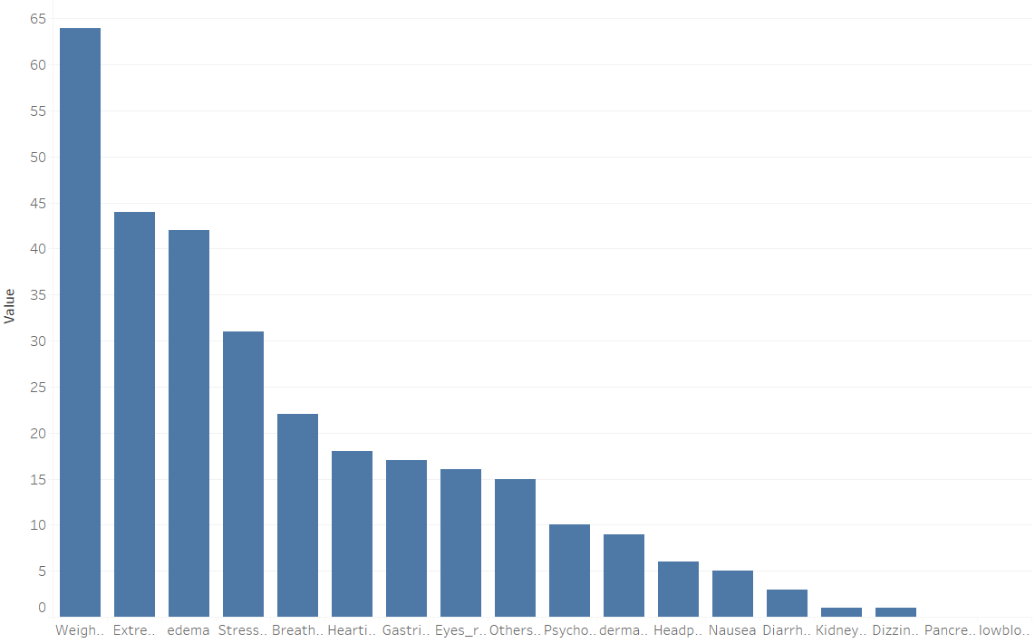
Result Comparison
The top 3 adverse drug reactions:
1. Diarrhoea
2. Stomach issues
3. nausea
Top 3 adverse drug reactions:
1. Weight-change
2. Extreme pain
3. edema

Slide 15
Conclusion and future work
In this work, we have demonstrated that we can get different adverse drug reaction insights from social media analysis compared to Askapatient online health community dataset analysis.
This will help doctors and health experts to answer important questions in the domain of knowledge discovery
The work can be applied to any medicine to discover its side effects, associations and patterns, predictions and forecasting.
Future work is to explore better visualization techniques that can provide better insights of the healthcare data.

Slide 16
Thank you!

